Slide 1
Provost’s Challenge for Excellence and Equity: LOBOS CONNECT
Two grant- and research-based opportunities to reduce equity gaps in General Education and Gateway Courses:
Student Experience Project (SEP)
Expanding Course Based Undergraduate Research Experiences (ECURE)

Slide 2
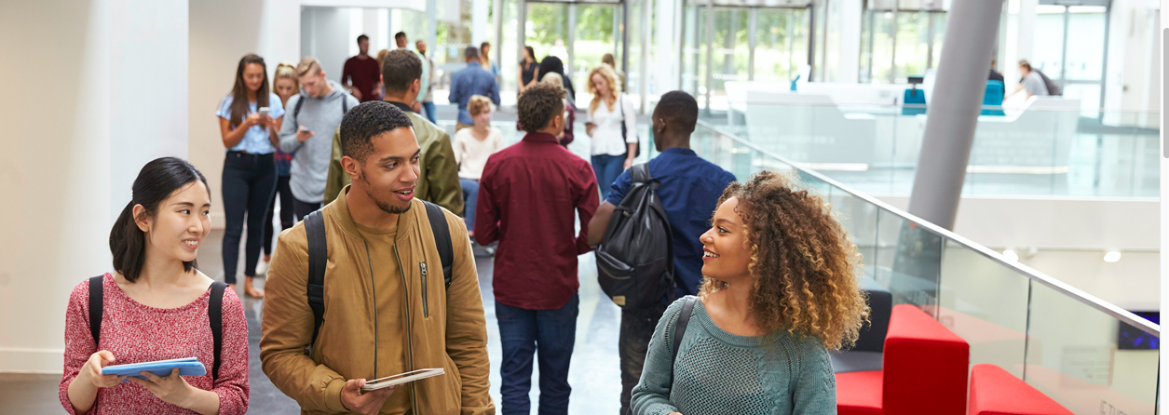

Slide 3
Notes:
These are the results of the APLU-Student Experience Survey at UNM on feelings of belonging. The most significant differentials are around generation in college, degree of financial stress and transfer status.

Slide 4
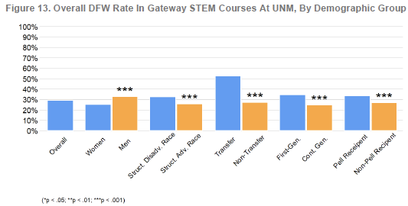
UNM Selected Research Results: DFW Rates in Gateway STEM Courses

Slide 5
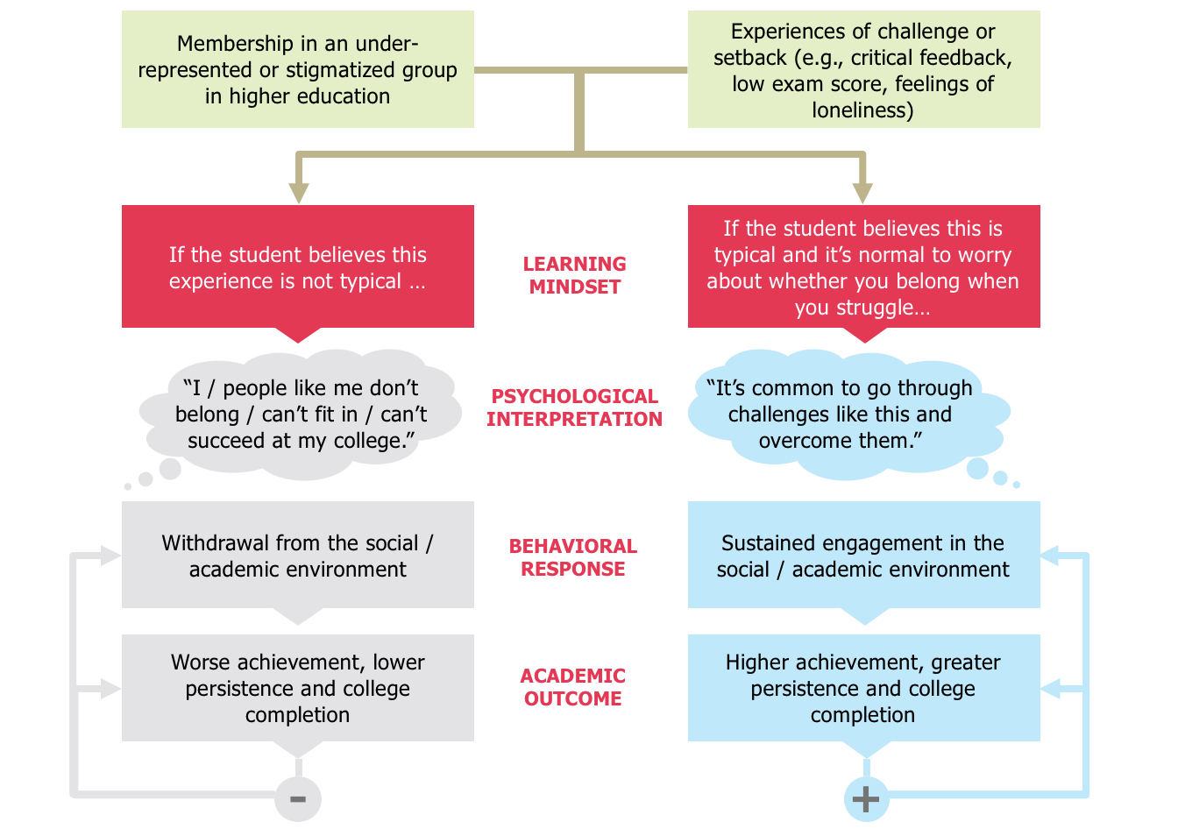
How Learning Mindsets Affect Students
Adapted from diagram designed by Mindset Scholars Network
Notes:
Students from structurally disadvantaged groups come to campus knowing they will face underrepresentation, negative cultural stereotypes about their abilities, and other barriers.
So they are paying particular attention to signals whether the institution, their professors, and the other students do see they, or people like them, as belonging on campus, and that they, or people like them can succeed there.
When they run into challenges, like struggles with difficult course material or feeling intimidated by professors, it is understandable that they could take that as a sign that they don’t belong or can’t succeed.
SEP learning partners have dozens of field and lab studies showing that once students draw this conclusion, it can lead them to disengage academically (e.g. not going to professors’ office hours, not asking questions in class) and socially (e.g. not joining extracurriculars or study groups), as well as affecting their academic performance and retention. This process does contribute to some of the disparities in academic outcomes we see between groups, and addressing these processes has been shown to help reduce disparities.

Slide 6
Instructors Who Foster a Sense of Belonging in College
Convey that their classroom is a place where all students belong
Convey that almost everyone faces challenges (e.g. lower grades; feeling intimidated by course material)
Convey that such challenges are not a sign that a student does not belong there
Convey that by giving it time, and taking agentic steps, most students do come to feel a sense of belonging
Notes:
Speaker notes – same as slide.

Slide 7
Instructors Who Communicate a Growth Mindset
Convey that academic ability is malleable, and not the result of innate qualities
Convey that students can improve their academic ability over time with effort, feedback, and using effective strategies for learning
Notes:
Speaker notes – same as slide

Slide 8
Instructors Who Communicate a Fixed Mindset
Convey that academic ability is fixed and students can’t do much to change it
Convey that some students have what it takes to succeed, and some students don’t
Have a disproportionately negative effect on students from structurally disadvantaged groups
Notes:
Speaker notes – same as slide

Slide 9
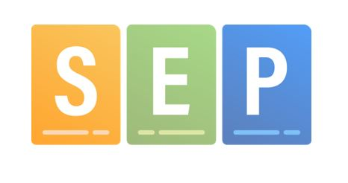
Results from the First Semester
60 Faculty Fellows Participated
35 as Implementation Fellows
25 as Exploratory
Faculty Reflections
A review of all faculty fellows’ reflections showed that 63% of all notes were about successes (general satisfaction or a good experience) with implementation strategies deployed in the classroom.
About 35% of all notes centered on difficulties with remote learning, or constraints faced by students and faculty outside the classroom.
Faculty fellows were generally happy with their participation.
Figure 2. Frequency of Mentioned Intervention Strategies by Change Idea Group

Slide 10
What did fellows say about the changes they made?
“I love my revised syllabus and I look forward to making similar changes in all my classes.”
“I felt better for having revised the language in my syllabus to be more encouraging and supportive. That activity helped me rethink my approach to teaching during the pandemic (and in the future) to support student learning and other aspects of their lives. I don't have any evidence that it changed how students feel about the class, but maybe changing my approach is just as important.
I’ve found that giving more leeway in terms of deadlines (mostly because of COVID) hasn’t lowered my standards but appears to have reduced their stress levels significantly.”
“Office hours renamed to drop-in hours and they have been heavily attended. More so than a regular semester, so after we go to face to face, I plan on offering at least one of my office hours online.”
“Established a new ‘stuff happens’ policy and have been surprised at how relatively few students invoked it.”

Slide 11
What kinds of challenges did the community of practice encounter together during a difficult semester?
“I'm not sure how well prepared many students were for taking on the burden of learning in a different way [remotely]. I need to figure out how to be more explicit about their responsibilities and how to best provide support for them to learn more independently.”
“I found teaching via zoom to be much harder than in person. There is no room for error, else you quickly lose the students attention. I found I had to go much slower than in person since I need to wait longer for their response, while in person I more quickly sense whether they got it or not.”
“Students were more reticent than expected to participate in group activities. I found that they needed a lot more structure in groups than I expected.”
These issues and many others were discussed by the faculty fellows during monthly SEP STEP Meetings.

Slide 12
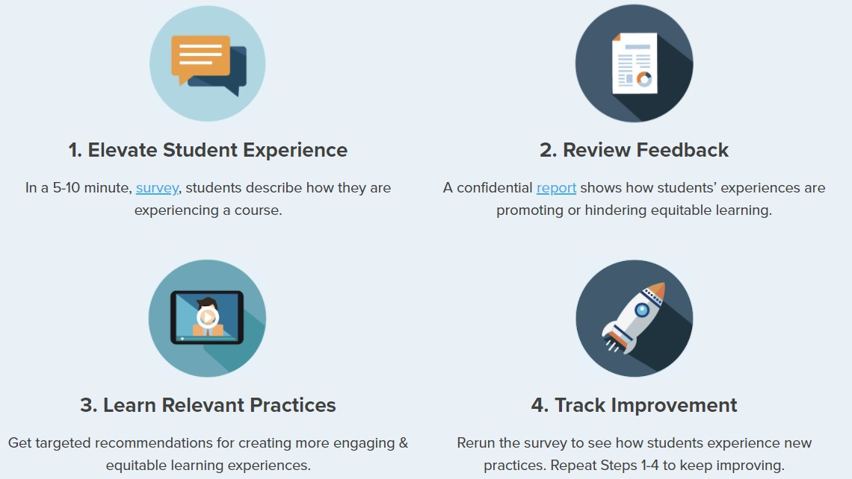
CoPilot Ascend: Measuring the Student Experience

Slide 13
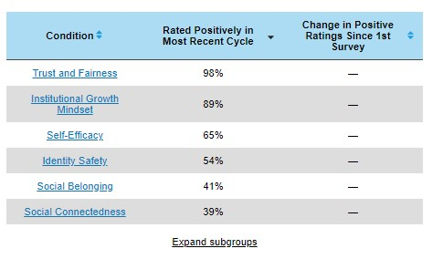
CoPilot Ascend: For an individual faculty member….

Slide 14
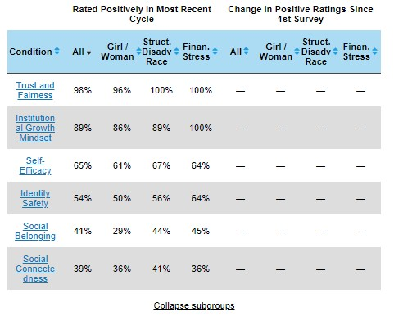
CoPilot Ascend: For an individual faculty member….

Slide 15
CoPilot Ascend: For an individual faculty member….

Slide 16
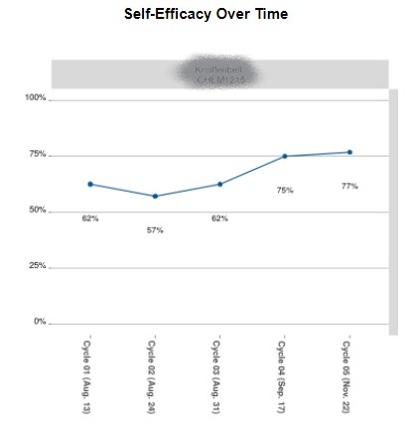
CoPilot Ascend: For an individual faculty member….

Slide 17
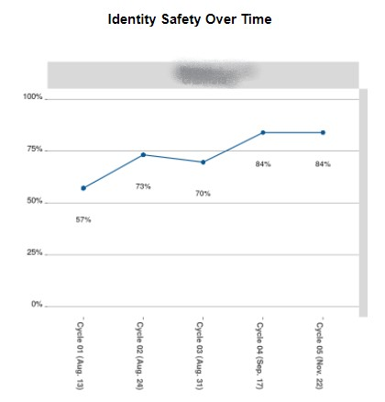
CoPilot Ascend: For an individual faculty member….

Slide 18
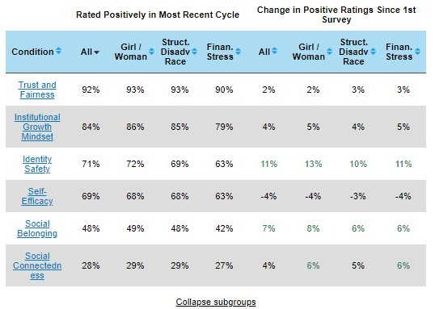
CoPilot Ascend: UNM community report Fall 2020

Slide 19
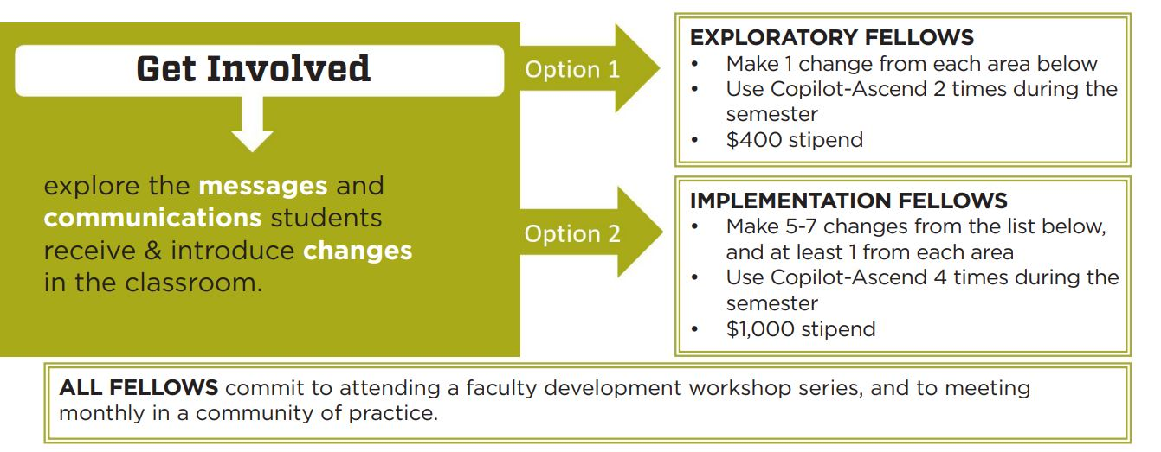

Slide 20
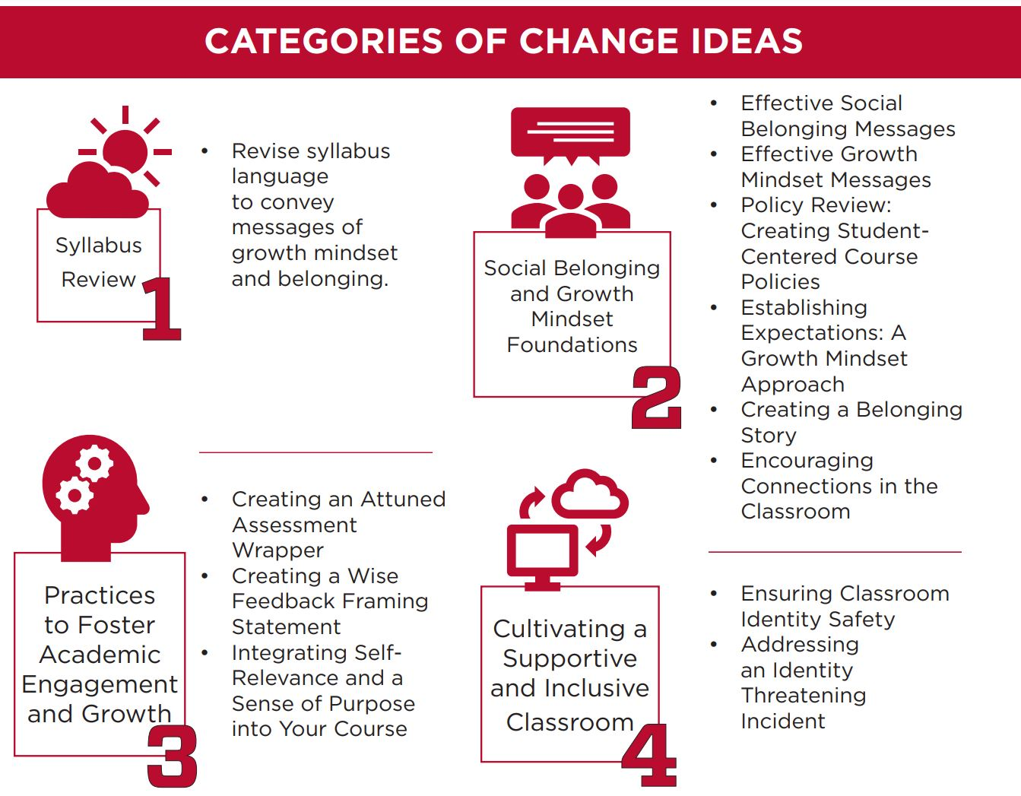

Slide 21
Training and Resources
Faculty Development Workshop Series
SEP Framework and Assessment
Syllabus Workshop
Change Ideas
The SEP Practices Library
Descriptions of Practices
Examples
Supporting Research
CoPilot Ascend Orientation

Slide 22
Faculty Fellows’ SEP Support
The UNM SEP Team
Lead: Pamela Cheek
Science Lead: Sushilla Knottenbelt
IRB and Scientific Support: Andrew Rowland
Project Manager: Joe Suilmann
Institutional Analysis: Charla Orozco
Data Analysis: Mónica Jenrette
Champions: Monica Nitsche and Kelly Howe
From Outside UNM
SEP PI: Mary Murphy, VP for Equity and Inclusion Indiana University
Participants from other SEP Institutions
Communication
Weekly Updates
Monthly SEP STEP Meetings with the Faculty Fellows Community of Practice
E-Mail Helpline: StudentExperienceUNM@unm.edu
UNM SEP Teams Site
National SEP and PERTS Teams

