Slide 1
ECURE
Expanded Course-based Undergraduate Research Experiences

Slide 2
ECURE
OVERVIEW
Funding Source: National Science Foundation, Improving Undergraduate STEM Education (IUSE), Hispanic Serving Institutions Program
Funding Amount: $2.1M over five years, Continuing Award
Funding Term: April 15, 2020 through April 14, 2025; Starting in the second year, funding is contingent on successful progress

Slide 3
ECURE
THE
ECURE
FRAMEWORK

Slide 4
ECURE
Traditional CURE Framework, students engage in ALL of the following elements of authentic research

Slide 5
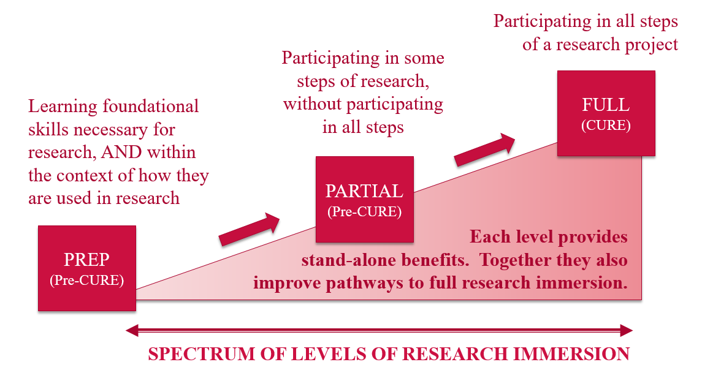
Expanded Course-based Undergraduate Research Experience Framework, in brief
ECURE
Developed by the UNM Academic Affairs General Education Teaching Fellows, 2018-19

Slide 6
Expanded Course-based Undergraduate Research Experience Framework, in brief
ECURE
PREP
PARTIAL
FULL
ETHICAL AWARENESS
GATHERING BACKGROUND
EVIDENCE PREPARATION
COMMUNICATION/COLLABORATION
REAL-WORLD RESEARCH PRACTICE
FREEDOM TO DISCOVER
FAILURE AND ITERATION
OUTCOME NOVELTY
Developed by the UNM Academic Affairs General Education Teaching Fellows, 2018-19

Slide 7
ECURE
ECURE
FELLOWSHIPS

Slide 8
ECURE
TYPES OF COURSES FOR ECURE IMPLEMENTATION
General Education Courses: Courses within STEM disciplines that count as general education options. We will prioritize these courses for FULL research engagement, where possible.
STEM Portal Courses: The first one or two courses generally encountered by students in STEM disciplines.
WHAT DISCIPLINES CONSTITUTE STEM
For this purpose, STEM is defined as those disciplines which can be supported by NSF funding (which includes economics, sociology, psychology and anthropology, in addition to engineering and traditional science disciplines). For a full list of disciplines, please go to:
http://stem.unm.edu/about-stcc/what-is-stem.html

Slide 9
ECURE
TYPES OF ECURE FELLOWS
LEVEL | DEFINITION
Implementation (20 available fellowships, at $4,000 one-time summer stipend each) | Implementation Fellows will develop and implement ONE of the three levels of immersion in at least one section of a STEM general education or portal course in the Fall 2020, Spring 2021 and/or Summer 2021.
Exploration (12 available fellowships, at $1,000 one-time summer stipend each) | Exploratory Fellows will explore the use of the ECURE framework in their courses by observing their peers implement projects, but will not commit to an implementation themselves. Exploratory Fellows will be encouraged to apply as Implementation Fellows next year, if they feel this is an appropriate framework for their course(s).
Publication (starting in summer 2021) | Past Implementation Fellows will be encouraged to participate as Publication Fellows, utilizing ECURE resources and support to publish findings from their implementation project.

Slide 10
ECURE
LEVELS OF IMMERSION, OPERATIONALIZED FOR ECURE
LEVEL | DEFINITION
Preparatory | Throughout the course of the semester, students in PREP sections will participate in at least ten separate activities, assignments or focused lectures addressing research skills or research-applied foundational skills during the course of an academic term.
Partial | Throughout the course of the semester, students in PARTIAL sections will engage in at least two research steps, where students ask or answer questions to which the answers are unknown.
Full | In FULL experiences, students participate in all stages of the research project.

Slide 11
ECURE
ECURE RESOURCES AND SUPPORT
Professional Development (Summer Institute, Communities of Practice, Year-Round Discussions and ad hoc events, as requested)
UNM Library Undergraduate Research Resource Guide (https://libguides.unm.edu/UGR-resources)
Publication Support (including access to student outcomes data and statistics support)
Other support mechanisms will be developed, as determined by Fellows

Slide 12
ECURE
OBLIGATIONS OF ECURE FELLOWS
Implementation Fellows and Exploratory Fellows commit to attend the virtual ECURE Summer Institute between May 24th and June 18th, with synchronous sessions scheduled only on Monday afternoons during this timeframe. All other engagements during the Summer Institute will be asynchronous, and can be arranged to meet your individual schedule. You should expect to spend 10-15 hours per week on the ECURE Summer Institute between during the Summer Institute. This professional development program will introduce instructors to the ECURE framework and assessment mechanisms, as well as active learning strategies and culturally inclusive instruction.
Implementation Fellows and Exploratory Fellows commit to meeting monthly with the ECURE community of practice. These meetings may be more or less frequent as determined by the participants. Fellows will also have the option to participate in asynchronous online discussions with their UGR peers at UNM.

Slide 13
ECURE
OBLIGATIONS OF ECURE FELLOWS
Implementation Fellows commit to assigning their students to complete an ECURE pre and post assessment survey. This survey will not take longer than 30 minutes to complete, and can be assigned as an in-class activity or as out-of-class homework. We request that instructors provide incentive for students to complete the survey, possibly through points towards the final grade or through extra credit points.
Implementation Fellows commit to allowing classroom observations by members of the community of practice, and ECURE staff/researchers. These observations will be at the discretion of the instructors, and will be scheduled based on instructor preferences. Exploratory Fellows commit to observing at least three classroom sessions in Fall 2021, Spring 2022 and/or Summer 2022.
Implementation and Exploratory Fellows commit to completing an instructor survey at the conclusion of Summer 2022. This survey will not take longer than 25 minutes to complete.

Slide 14
ECURE
OBLIGATIONS OF ECURE FELLOWS
Implementation Fellows commit to completing a two-page summary of their project at the end of Summer 2022. A template will be provided for the report.
OPTIONAL: If Implementation Fellows would like to share their curriculum modules with peers at UNM and other institutions, we will provide a module template for doing so. We will post these modules on the ECURE website, and will distribute to other non-UNM sites as appropriate.

Slide 15
ECURE
ECURE Leadership Team
James Holloway (PI), Associate Vice President for Research.
Pamela Cheek (Co-PI), Associate Provost for Student Success.
Tim Gutierrez (Co-PI), Associate Vice President of Student Services.
Hua Guo (Co-PI), Distinguished Professor of Physical Chemistry.
Erik Erhardt (Co-PI), Associate Professor of Statistics.
Assata Zerai. Vice President for Equity and Inclusion.
Jason Moore, Assistant Professor of Paleontology, Honors College.
Charles Fledderman, Associate Dean for Academic Affairs in the School of Engineering.
Greg Lanier, Dean of Honors College.
Diane Marshall, Associate Dean for Instruction & Curriculum in the College of Arts and Sciences.
Aeron Haynie, Executive Director of the Center for Teaching and Learning.
Rosa Isela Cervantes, Director of El Centro de la Raza (Hispanic student services center).
Nancy López, Professor of Sociology.
Kimberly Fournier, Associate Director of the Center for Teaching and Learning.
Eva Stricker, Research Assistant Professor of Biology.
Vanessa Svihla, Associate Professor of Organization, Information & Learning Sciences.
Davood Tofighi, Assistant Professor of Psychology.
Tim Schroeder, ECURE Project Director and Grand Challenges Operations Director.
Lynn Nordstrom, External Evaluator.
Monica Jenrette, Data Coordinator.

Slide 16
ECURE
Year One Fellows
Fall 2020 Implementations: 5 courses (16 sections total)
Spring 2021 Implementations: 6 courses (11 sections total)
ECURE Exploratory Fellows: 11
ECURE Implementation Fellows; 11
OVPR-funded Fellows: 6

Slide 17
?
ECURE
Questions

